Slide 1

Generalization of Trigonometric, Hyperbolic and Fibonacci-Lucas identities with symbolic computations
Gayanath Chandrasena
University Of Sri Jayewardenepura
Department of Mathematics

Slide 2
References
Burton, D.M. (2016). Elementary number theory. New Delhi, India: McGraw-Hill Education (India) Private Limited.
Conway, J. and Ryba, A. (2013). 97.39 Fibonometry. The Mathematical Gazette, 97(540), pp.494–495.
Senadheera, J.N. (2021).An unusual Generalization, Elementary problems and solutions, Fibonacci Quarterly, Number 4, volume 59, pp.370-371

Slide 3
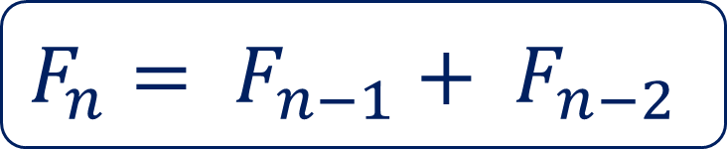

Definition of Fibonacci sequence
What are “Fibonacci-Lucas” sequences?
Fibonacci sequence ($F_{n}$):
$F_{0}=0$, $F_{1}=1$
For $n≥2$,
0, 1, 1, 2, 3, 5, 8,13, 21, 34,…
$$F_{n}= F_{n−1}+ F_{n−2}$$

Slide 4
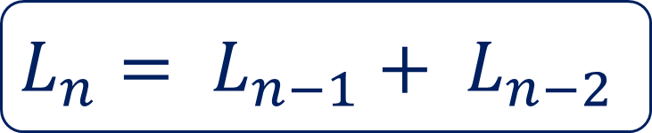

Definition of Lucas’ sequence
Lucas’ sequence ($L_{n}$):
$L_{0}=2$, $L_{1}=1$
For $n≥2$,
2, 1, 3, 4, 7, 11, 18,29, 47,…
$$L_{n}= L_{n−1}+ L_{n−2}$$

Slide 5
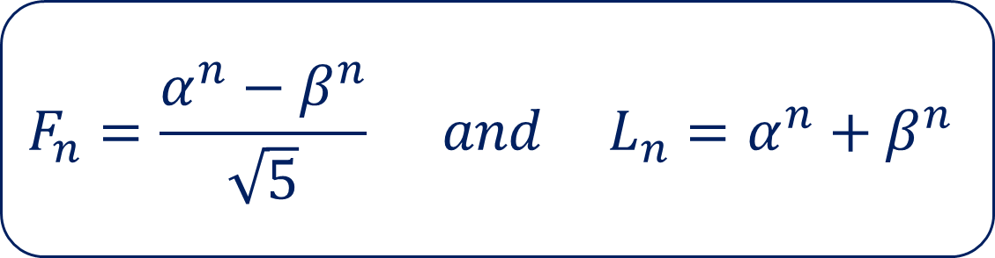

Closed form formula for Fibonacci-Lucas’ numbers
where,
$α=\frac{1+\sqrt{5}}{2}$ and $β=\frac{1−\sqrt{5}}{2}$
$$F_{n}=\frac{α^{n}−β^{n}}{\sqrt{5}} and L_{n}=α^{n}+β^{n}$$

Slide 6


Euler’s formula for $sinθ$ and $cosθ$
$$sinθ= \frac{e^{iθ}−e^{−iθ}}{2i} and cos θ=\frac{e^{iθ}+e^{−iθ}}{2}$$

Slide 7


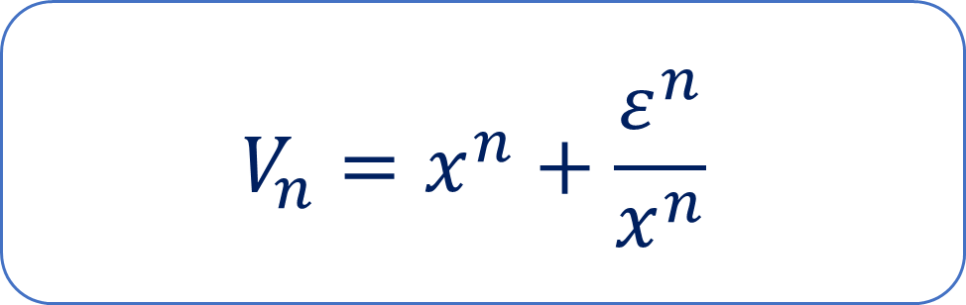
Generalization(Symbolic Trigonometry)
Where $ε∈\{1,−1\}$
$$U_{n}=x^{n}−\frac{ε^{n}}{x^{n}}$$
$$V_{n}=x^{n}+\frac{ε^{n}}{x^{n}}$$

Slide 8
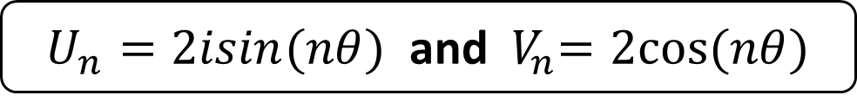


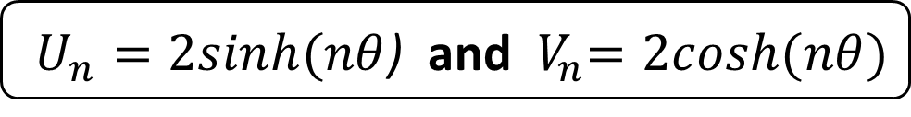
Why it is a generalization?
${x=e}^{iθ}$and $ε=1$(Trigonometric)
${x=e}^{θ}$ and $ε=1$(Hyperbolic)
$x=\frac{1+\sqrt{5}}{2}$ and $ε=−1$(Fibonacci-Lucas)
$U_{n}=2isin(nθ)$ and ${ V}_{n}=2cos⁡(nθ)$
$U_{n}=2sinh⁡(nθ$) and ${ V}_{n}=2cosh⁡(nθ)$
$U_{n}=\sqrt{5}F_{n}$ and $V_{n}=L_{n}$

Slide 9
Why above generalization is useful?
To prove the identities in each field in more symmetric way.
Convert the identities in one field to another field.
Facilitate to establish the identities using symbolic computations.

Slide 10

Straightforward calculations follows…
1.${ U}_{0} =0$ and ${ V}_{0} =2$
2. $U_{−n} = −\frac{1}{ε^{n}}{ U}_{n}$ and ${ V}_{−n} =\frac{1}{ε^{n}}{ V}_{n}$
3. ${ U}_{m}U_{n}=V_{m+n}−ε^{n}V_{m−n}$
4. ${ V}_{m}V_{n}=V_{m+n}+ε^{n}V_{m−n}$
5. ${ U}_{n}V_{m}=U_{m+n}−ε^{n}U_{m−n}$

Slide 11
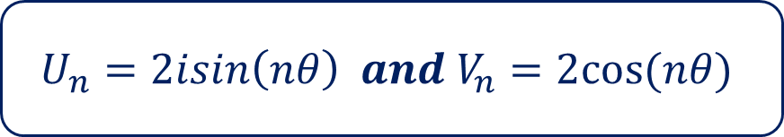

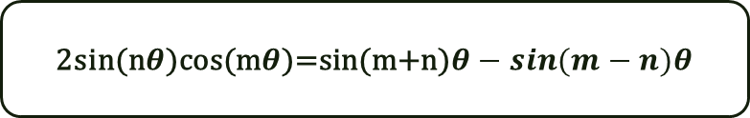
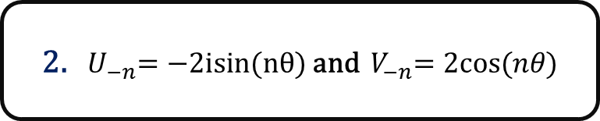
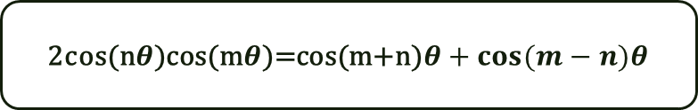
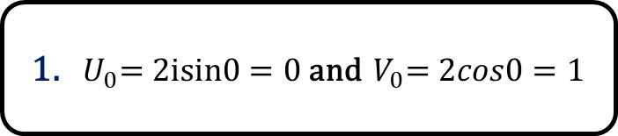
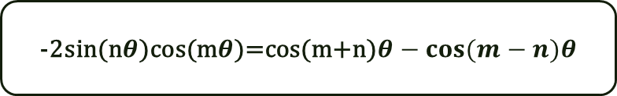
Conversion to trigonometry
${x=e}^{iθ}$and $ε=1,$
$$U_{n}=2isin\left(nθ\right) and V_{n}=2cos⁡(nθ)$$
1.${ U}_{0}=2isin0=0$and ${ V}_{0}=2cos0=1$
2.${ U}_{−n}=−2isin(nθ)$and ${ V}_{−n}=2cos⁡(nθ)$
-2sin(n$θ$)cos(m$θ$)=cos(m+n)$θ−cos⁡(m−n)θ$
$${3. U}_{m}U_{n}=V_{m+n}− V_{m−n}$$
2cos(n$θ$)cos(m$θ$)=cos(m+n)$θ+cos⁡(m−n)θ$
$${4. V}_{m}V_{n}=V_{m+n}+ V_{m−n}$$
5.${ U}_{n}V_{m}=U_{m+n}−U_{m−n}$
2sin(n$θ$)cos(m$θ$)=sin(m+n)$θ−sin⁡(m−n)θ$

Slide 12

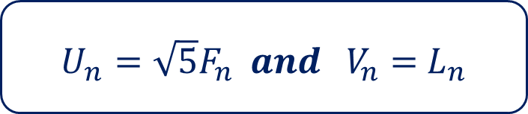
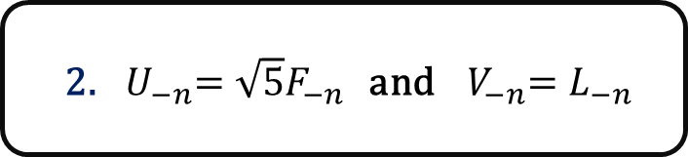

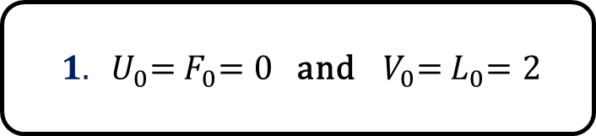


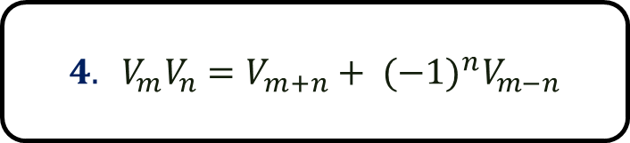
Conversion to Fibonacci –Lucas’ Identities
x=$\frac{1+\sqrt{5}}{2}$ and $ε=−1,$
$U_{n}=\sqrt{5}F_{n} and V_{n}=$ $L_{n}$
${ 1. U}_{0}={ F}_{0}=0$and ${ V}_{0}={ L}_{0}=2$
2.${ U}_{−n}={\sqrt{5}F}_{−n}$ and ${ V}_{−n}=L_{−n}$
3.${ U}_{m}U_{n}=V_{m+n}−{(−1)}^{n}V_{m−n}$
$${ 5F}_{m}F_{n}=L_{m+n}−{(−1)}^{n}L_{m−n}$$
$$4. V_{m}V_{n}=V_{m+n}+ {(−1)}^{n}V_{m−n}$$
${ L}_{m}L_{n}=L_{m+n}+{(−1)}^{n}L_{m−n}$
$${5. U}_{n}V_{m}=U_{m+n}− {(−1)}^{n}U_{m−n}$$
$$F_{n}L_{m}=F_{m+n}−{(−1)}^{n}F_{m−n}$$

Slide 13
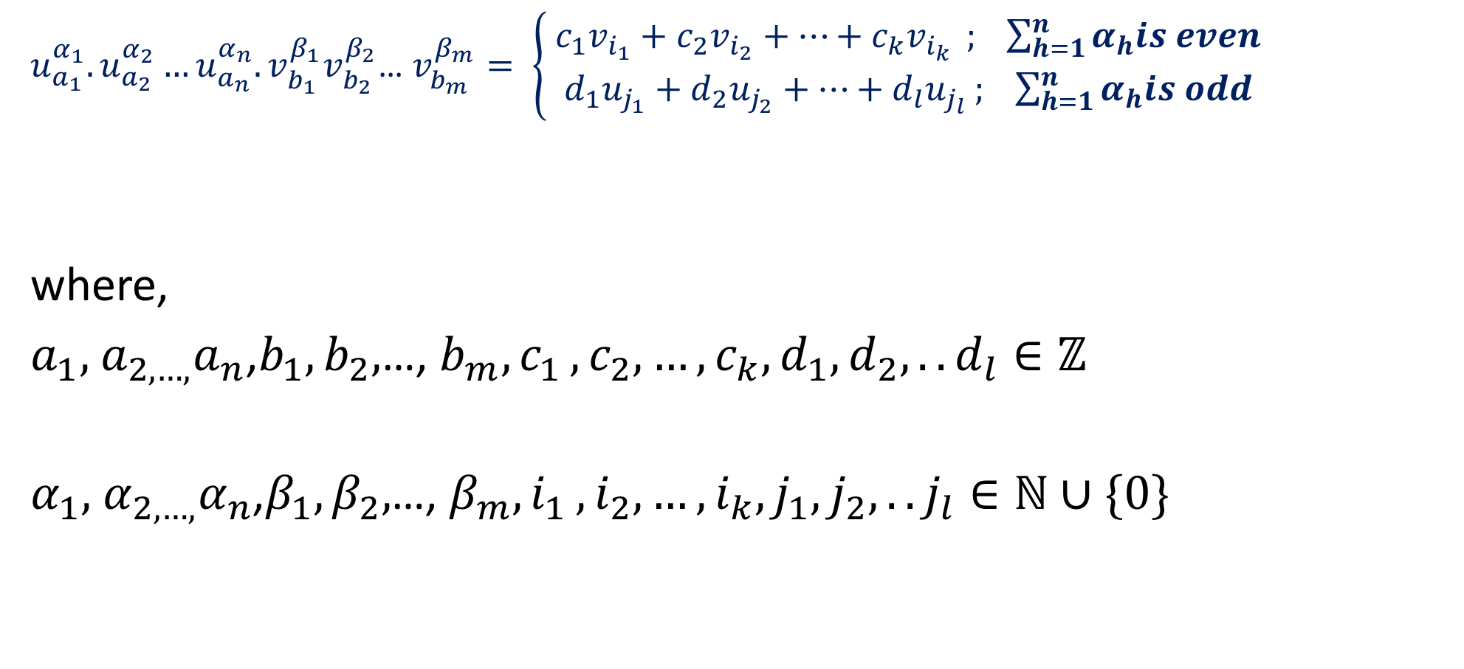
Theorem
$u_{a_{1}}^{α_{1}}.u_{a_{2}}^{α_{2}}…u_{a_{n}}^{α_{n}}.v_{b_{1}}^{β_{1}}v_{b_{2}}^{β_{2}}$… $v_{b_{m}}^{β_{m}}= \left\{\begin{aligned}{ c}_{1}v_{i_{1}}+c_{2}v_{i_{2}}+…+c_{k}v_{i_{k} } ; \sum_{h=1}^{n}{α_{h}is even} \\ d_{1}u_{j_{1}}+d_{2}u_{j_{2}}+…+d_{l}u_{j_{l}} ; \sum_{h=1}^{n}{α_{h}is odd}\end{aligned}\right.$
where,
$a_{1},$ $a_{2,…,}a_{n}$,$b_{1},b_{2},$…, $b_{m}{,c}_{1},c_{2},…,c_{k},d_{1},d_{2},..d_{l}∈ℤ$
$α_{1},$ $α_{2,…,}α_{n}$,$β_{1},β_{2},$…, $β_{m}{,i}_{1},i_{2},…,i_{k},j_{1},j_{2},..j_{l}∈ℕ∪\{0\}$

Slide 14
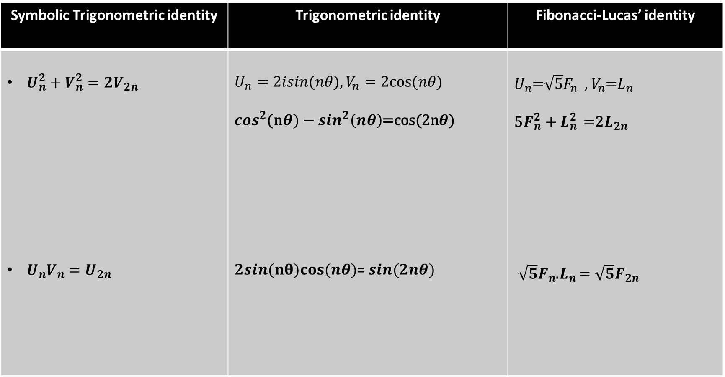
Comparison
Symbolic Trigonometric identity | Trigonometric identity | Fibonacci-Lucas’ identity
$U_{n}^{2}+V_{n}^{2}=2V_{2n}$ $U_{n}V_{n}=U_{2n}$ | $$U_{n}=2isin(nθ),V_{n}=2cos⁡(nθ)$$ $\cos^{2}$(n$θ)−\sin^{2}\left(nθ\right)$=cos(2n$θ$) $2sin(nθ)cos⁡(nθ)$= $sin(2nθ)$ | $U_{n}$=$\sqrt{5}F_{n}$, $V_{n}$=$L_{n}$ 5$F_{n}^{2}+L_{n}^{2}$ =2$L_{2n}$ $\sqrt{5}F_{n}$.$L_{n}$ =$\sqrt{5}F_{2n}$

Slide 15

Symbolic proof for a Trigonometric Identity
sin 3θ = 3sinθ -4$\sin^{3}$θ
Let’s find ${U_{1}}^{3}$
${U_{1}}^{3}$= $U_{3}−{3εU}_{1}$
By substituting $U_{n}=2isin(nθ)$ and $ε=1$
$−8i.\sin^{3}θ$ = $2i.sin 3θ$- $6i.sinθ$
-4 $\sin^{3}θ$ = $sin 3θ$-3$sinθ$
$sin 3θ$ = 3$sinθ$ -4 $\sin^{3}θ$

Slide 16
Thank You!

